Slide 1
VLSI
Lecture-03

Slide 2
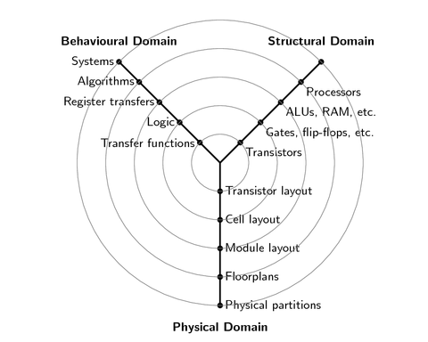
Gajski-Kuhn Y-chart
The Gajski-Kuhn Y-chart is a model which captures the considerations in designing semiconductor devices.
The three domains of the Gajski-Kuhn Y-chart are on radial axes.
Logical Synthesis, Layout Synthesis

Slide 3
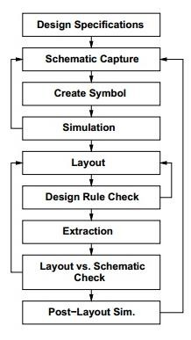
VLSI Design Flow
Specifications comes first, they describe abstractly, the functionality, interface, and the architecture of the digital IC circuit to be designed.
Behavioral description is then created to analyze the design in terms of functionality, performance, compliance to given standards, and other specifications.

Slide 4
Pass Transistors
The strength of a signal is measured by how closely it approximates an ideal voltage source.
In general, the stronger a signal, the more current it can source or sink.
An nMOS transistor is an almost perfect switch when passing a 0 and thus we say it passes a strong 0. However, the nMOS transistor is imperfect at passing a 1. The high voltage level is somewhat less than VDD.

Slide 5
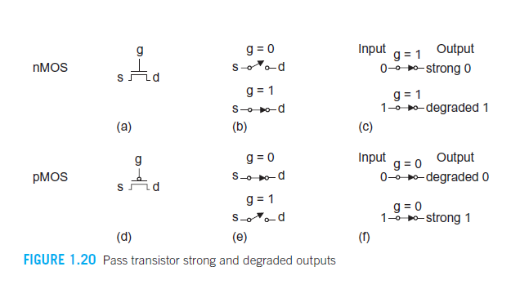
Pass Transistors
A pMOS transistor again has the opposite behavior, passing strong 1s but degraded 0s. When an nMOS or pMOS is used alone as an imperfect switch, we sometimes call it a pass transistor.

Slide 6
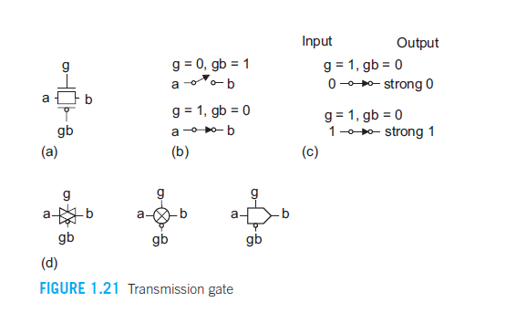
Transmission gate
By combining an nMOS and a pMOS transistor in parallel (Figure 1.21(a)), we obtain a switch that turns on when a 1 is applied to g (Figure 1.21(b)) in which 0s and 1s are both passed in an acceptable fashion (Figure 1.21(c)). We term this a transmission gate or pass gate.

Slide 7
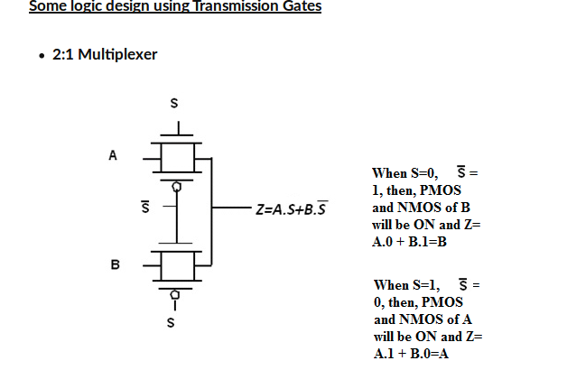
2:1 Multiplexer using transmission gate

Slide 8
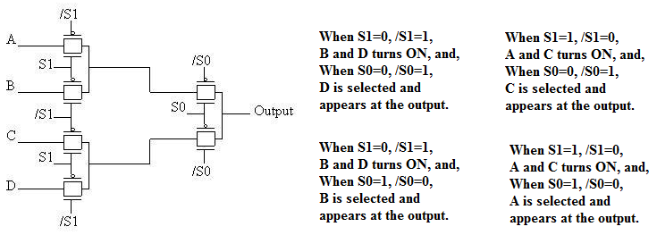
4:1 multiplexer using 2:1 TG

Slide 9
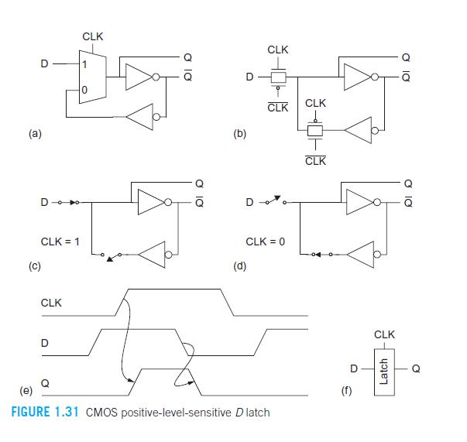
A D-latch built from a 2-input mux

